Slide 1
ROS Tutorial II
Lily, 2020/3/23

Slide 2
Outline
Service
Roslaunch
Apriltag

Slide 3
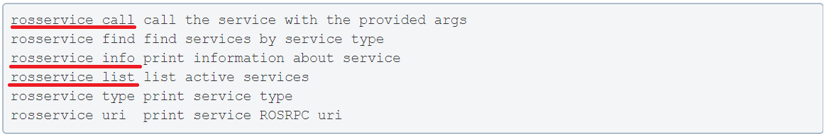
Service
Do you remember Publisher / Subscriber?
If you have Publisher and Subscriber, why do you need Service?
Request / Response behavior
You can create your own service just like message
Command line tools

Slide 4
Topic 1

Slide 5
Roslaunch (1/2)
So, we use so much terminal to run our nodes / start a master / play bag
Is there an easier way?
YES! What you need is 'roslaunch'
It is a tool that makes you
start a master
run multiple nodes locally and remotely
set parameters
launch file is a XML file with many tags you will use
Can also include other launch files

Slide 6
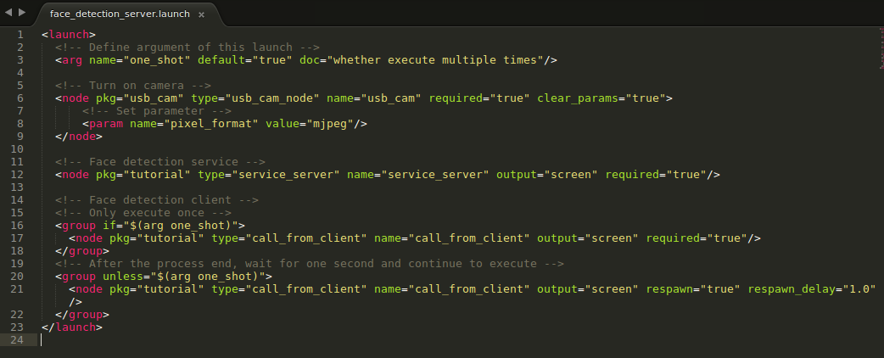
Roslaunch (2/2)
package name node name
file name

Slide 7
Apriltag (1/2)
apriltag_ros from RIVeR
Inputs:
image
camera_info (extrinsic / intrinsic matrix)
tag_size (size of black bolder)
Outputs:
tag_detection_array
ID
size
pose
TF

Slide 8
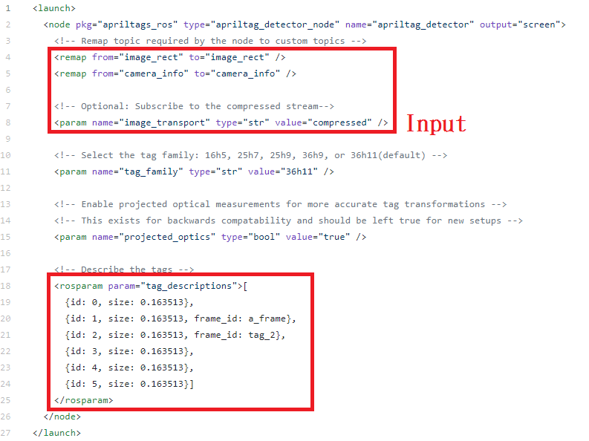
Apriltag (2/2)
How to use
Modify example.launch for your usage

Slide 9
Topic 2

